Slide 1
DCAA Career Opportunities
A DoD Career with Impact

Slide 2
Agenda
About DCAA
A Look at DCAA Auditing
Why Work for DCAA?
Opportunities for Students & Recent Grads
Applying for DCAA Positions
DCAA Contact Information
Q&A

Slide 3
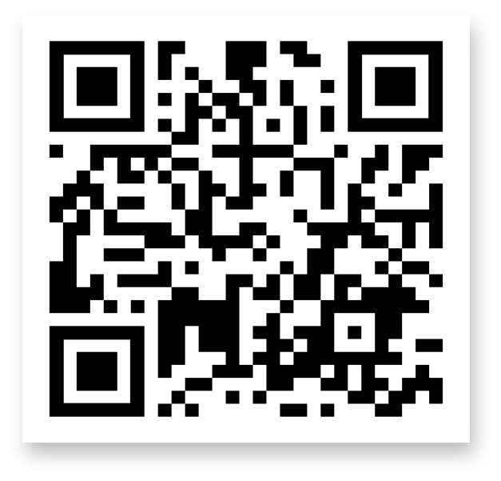
About DCAA

Slide 4
About DCAA
The Defense Contract Audit Agency (DCAA) is a vital Department of Defense (DoD) Agency. We conduct audits for DoD contracts for the supplies, services, and weapon systems essential to defending our Nation
From aircraft carriers to satellite systems to uniforms, we examine DoD contractors’ business processes, systems, and financial records to ensure that​ contract costs are fair and reasonable
Our audits result in government savings of approximately $3 billion every year, enabling DoD to achieve more with its acquisition investments
DCAA Mission: Supporting the warfighter. Protecting the taxpayer.

Slide 5
A Look at DCAA Auditing

Slide 6
Purpose and Focus
Government contract cost accounting is very different from financial statement auditing at commercial firms
We ensure that taxpayers and DoD get the best value for every dollar spent by evaluating documented costs to determine​ fair and reasonable pricing
We ensure costs are classified, segregated, allocated, and reported accurately

Slide 7
Variety - Audit Types
DCAA performs many different types of audits throughout the contract lifecycle. Common audit types and activities include:
Forward Pricing Audits that evaluate proposed costs, to help contracting officers negotiate before awarding a contract
System Audits that ensure a contractor can accurately track, report, and bill labor and material costs in accordance with government regulations
Incurred Cost Audits that assess contract costs billed, typically annually or before contract close-out, to avoid erroneous charges

Slide 8
Example Activities
Below are just some of the potential audit activities you may do at DCAA to ensure DoD contractors’ costs are allowable and reasonable:
Examine contractors’ financial statements and incurred costs
Review contractors' billing systems or time recording processes
Compare proposal pricing with costs for similar materials and/or federal regulations
Research market costs, pricing data, and financial regulations
Interview employees and complete labor floor checks
Write and present working papers or findings
Observe contractor assembly line operations

Slide 9
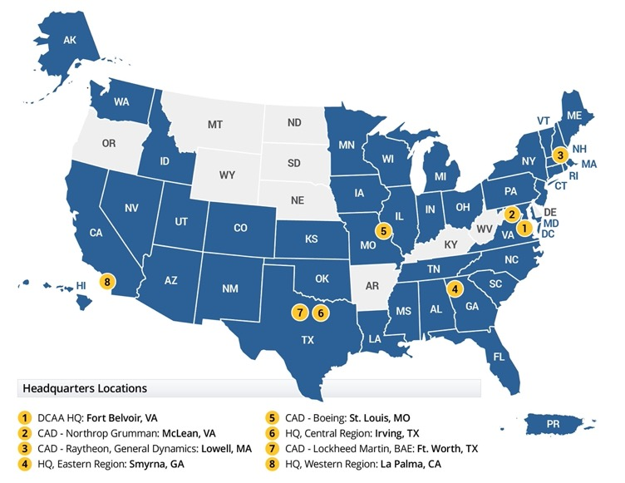
Variety in Contracts and Offices
DCAA has offices in 41 states and several international countries
Specific auditor responsibilities vary with the size and type of contract, the type of audit, and the DCAA office type
Some auditors audit a single company’s contracts at a contractor-based DCAA office. Other auditors work at a DCAA “branch office,” and travel to various contractor locations in smaller groups

Slide 10
Beyond a Desk Job
Our work is much more than a desk job. It may take you:
From an assembly line to a corporate boardroom
From an aircraft carrier to leading a presentation
From working with industry executives to visiting the labor floor of an F-35 manufacturing plant
There’s no other career in the financial world like one with DCAA!

Slide 11
What Makes a Great DCAA Auditor
Along with solid business/finance/accounting knowledge, DCAA auditors have:
Strong analytical, and written and verbal communications skills;
Ability to work independently or as part of a team; and
Willingness to learn the complexities of auditing DoD contracts
DCAA auditors are highly-motivated, detail-oriented, and complex thinkers
They piece together and analyze evidence to understand how a contractor’s entire business structure supports accurate recording of contract costs

Slide 12
Why Work for DCAA?

Slide 13
Why Work for DCAA?
A mission that matters
Extraordinary career development
Continuous learning
Stability and robust federal benefits
Competitive salaries
Varied work locations

Slide 14
Why Work for DCAA? A Mission That Matters
Our work has real impact in supporting the DoD mission:
We ensure our military and the taxpayer get the
best return on their investments
Our audits save taxpayers an average of
$3.4 billion annually
For every dollar DCAA spends, our audits return more than $5 back to the Treasury—which can be reinvested to our Nation

Slide 15
Why Work for DCAA? Extraordinary Career Development
DCAA has its own accredited educational institution, the Defense Contract Audit Institute.
DCAA provides robust training and certification for new auditors and employees, and extensive specialized training for experienced auditors
Employees grow through mentoring and coaching programs, leadership development, and other career development programs
Employees also have opportunities for financial reimbursement for advanced degrees and relevant certifications

Slide 16
Why Work for DCAA? Stability and Robust Benefits
The stability and portability of a federal government job
Generous paid time off programs
Flexible work schedules and programs for work-life balance
A variety of health and life insurance options
Transit subsidies
The potential for education reimbursement and college loan forgiveness
A three-part federal retirement program

Slide 17
Why Work for DCAA? Competitive Salaries
Market-competitive base salary as well as locality pay
Quick advancement for entry-level auditors:
Auditors meeting performance requirements can be reviewed for promotion to the next level in 52 weeks
An entry-level auditor at General Schedule (GS) level 7 could advance to the GS-12 level within three years, coming with significant increases in salary

Slide 18
Why Work for DCAA? Varied Work Locations
DCAA auditors work across the country and beyond:
More than 200 offices in 41 states
Select locations in Europe, the Middle East, Asia, and other areas
Opportunity to volunteer for deployment to a conflict zone and work alongside our active-duty troops
Wherever DoD contractors and suppliers are working for our government, DCAA auditors will be there.

Slide 19
Employee Experience & Perspectives
Visit our YouTube channel to check out employee testimonials detailing why a career as a DCAA auditor is so meaningful and rewarding

Slide 20
Career Opportunities for Students & Recent Graduates
Pathways Program and Permanent Positions

Slide 21
Pathways Program Opportunities at DCAA
The Federal Pathways Programs offer paid job experience and on-the-job training
The Internship Program provides long-term opportunities with flexible hours while you are still in school
The Recent Graduates Program provides full-time entry-level jobs
If positions are available, participants who complete all program requirements and have satisfactory job performance may transition to permanent positions

Slide 22
Qualifications for Permanent Positions
You can meet the basic requirements for an auditor position by either:
Education Requirements:
Bachelor's degree in accounting/auditing; OR
Bachelor's degree in business administration, finance, or public administration that includes 24 semester hours of accounting
Combination of Experience and Education:
At least 4 years of experience in an accounting/auditing career plus one of the following:
24 semester hours in accounting/auditing (up to 6 hours in Business Law); OR
Licensed as a Certified Public Accountant (CPA) or Certified Internal Auditor (CIA)

Slide 23
Applying for DCAA Positions

Slide 24
Applying for DCAA Positions
Visit DCAA.mil/Careers > How to Apply to take advantage of the application resources and tips on the DCAA site. Click link at top of page to apply
Create an account on USAJOBS (usajobs.gov) and search for DCAA open positions
Review the job announcement and tailor your resume to the requirements; include details and examples for all job requirements

Slide 25
Applying for DCAA Positions, Cont’d
Upload your transcripts
Complete the Initial Qualifications Assessment
When prompted by email, complete the USA Hire Assessment; you must achieve the minimum passing score to be considered for a DCAA position
If selected, participate in an interview with a panel of DCAA audit staff

Slide 26
DCAA Contacts and Q&A

Slide 27
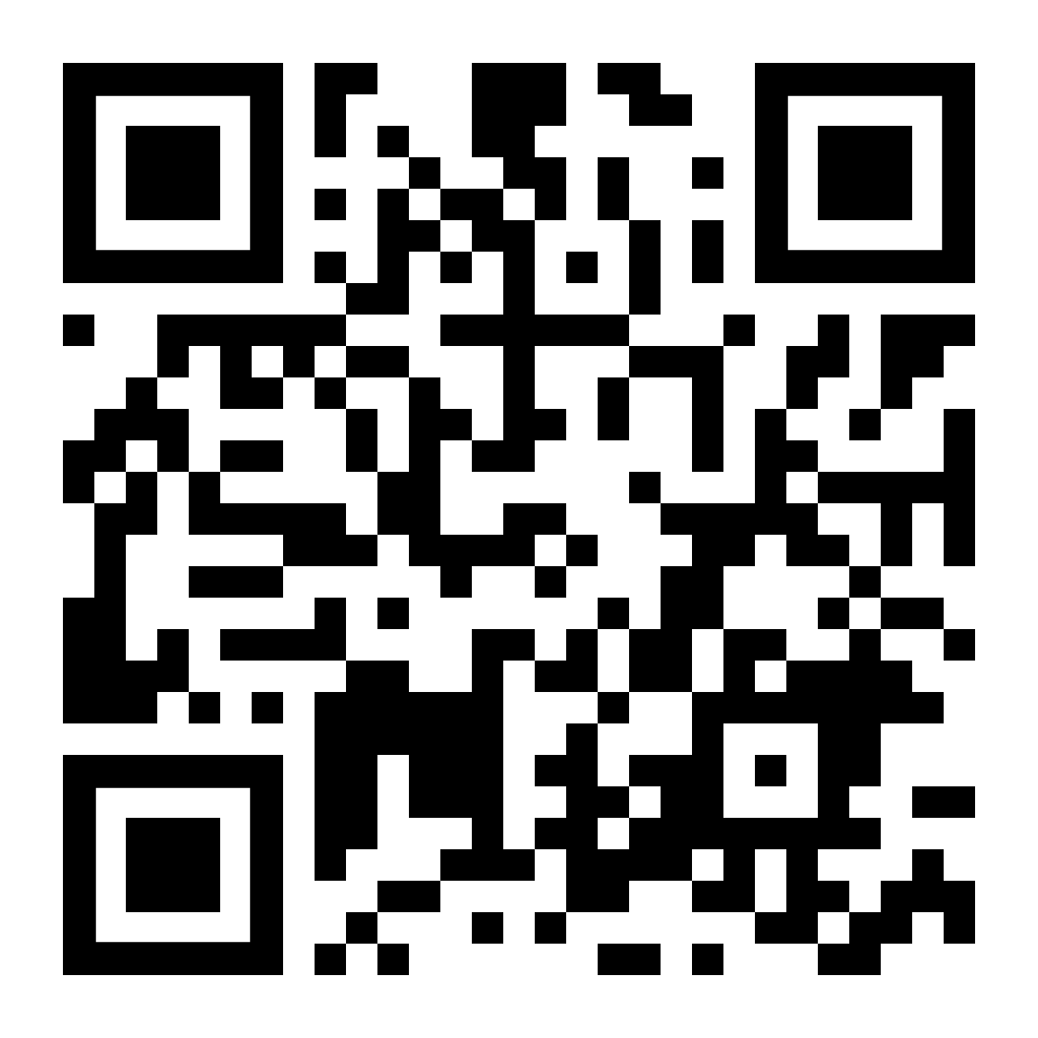
Learn More About DCAA
Visit: DCAA.Mil/Careers
Connect: Click stay connected on our website to join our mailing list about DCAA careers, recruiting events and more
Follow: DCAA on Facebook, LinkedIn and You Tube for job opportunities, agency accomplishments and impact and why you should #JointheMission
Email: Recruitment@dcaa.mil
Apply: Click open positions on our website to begin the application process

Slide 28
Stay Connected
Recruiters attend several career fairs around the country
DCAA also hosts several hiring events. Applicants can interview and receive job offers on the spot, if qualified
Visit our Upcoming Recruitment Events page to see where we will be

Slide 29
Questions?

Slide 30
Thank you for joining us today
We look forward to working with you!
#OurAuditorsRock

